Slide 1


MSCS Literacy
Commitment
Melanie Nelson, Principal
Kevin Morris, Assistant Principal
Tamara Turner, School Counselor

Slide 2

Literacy Commitment 2022-2023
NEW Simplified Indicator
Monitoring & Supporting K-2nd Grade Student Success Identifying At-Risk Students (Not used for retention) | 1st Grade | Second Grade
Kindergarten ELA Measure | 1st Grade ELA Measure | Second Grade ELA Measure
Universal Screener Assessment – iReady Fall: 353 Winter: 387 *Spring: 411 | Universal Screener Assessment – iReady Fall: 413 Winter: 445 *Spring: 475 | Universal Screener Assessment – iReady Fall: 290 Winter: 355 *Spring: 425
* If student does not meet the required score/level, it is HIGHLY RECOMMENDED that the student attends Summer Learning Academy.
*Update: The above table, for kindergarten and 1st grade, reflects the 65%tile normative score. The previous scores reflected the 50%tile.

Slide 3
Literacy Commitment:
Encompasses the State’s
TN Learning Loss Remediation &
Student Accelerated Student Learning
(2022-2023)
NEW POLICY
3rd Grade - 2022-2023
4th Grade – 2023-2024

Slide 4
What does the law say for 3rd graders?
Current 3rd Grade Students
Focus: “Accelerating Student Learning”
“Beginning with the 2022-2023 school year, a student in the third grade shall not be promoted to the next grade level unless the student is determined to be proficient in English Language Arts (ELA) based on the student's achieving a performance level rating of "on track" or "mastered" on the ELA portion of the student's most recent Tennessee comprehensive assessment program (TCAP) test.”

Slide 5
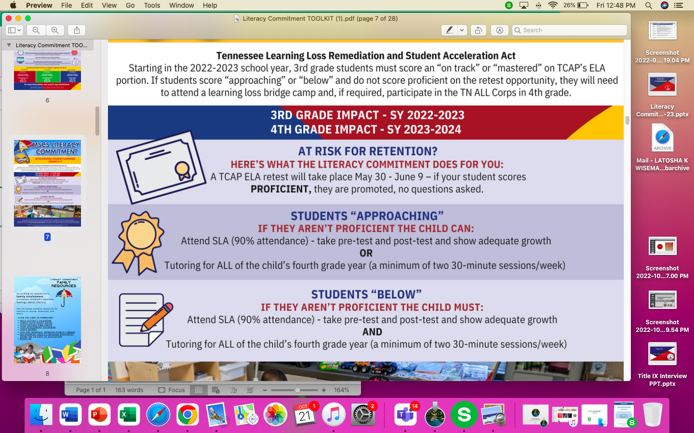
TN Learning Loss Remediation and Student Acceleration Act

Slide 6

TN Learning Loss Remediation and Student Acceleration Act
3rd graders can be to 4th grade if:
English Language Learners (ELL)
IEP or 504
Previously Retained
The student is an English language learner and has received less than two (2) full school years of ELA instruction;.
The student has a disability or suspected disability that impacts reading. The IEP or 504 team must convene a meeting to discuss if the student can be promoted.
The student was previously retained in any of the grades kindergarten through three (K-3).

Slide 7
TN Learning Loss Remediation and Student Acceleration Act
Appeal Process Overview
Only 3rd graders who score APPROACHING on the TCAP:
Who?
Parent or legal guardian must submit the appeal to the local department.
Memphis-Shelby County Schools
How?
All appeals MUST be submitted on the appropriate appeal forms provided by the Department and posted on its website.
The notice that the student is at-risk for retention shall be considered received on the day it is electronically sent.
When?
Appeal must be submitted within fourteen (14) calendar days of receipt of the notice
A designee(s) shall review all properly submitted appeals, decide, and issue an electronic notification of the decision to the parent or legal guardian within fourteen (14) calendar days of receiving the appeal.

Slide 8
Attendance:
Arrival Time: 7:45am-8:15am
8:16am: Students are marked tardy
Tardies, early dismissals, and absences can affect your child’s optional school status or choice transfer status. More importantly, they are missing instruction.
Receiving daily instructions from bell to bell can significantly improve your child’s academic performance.

Slide 9
Resources of Support:
Intervention:
Tier 2 and Tier 3 students receive intervention weekly.
Intervention takes place from 7:45am-8:15am with Ms. Jones. If your child is scheduled to receive face to face intervention from 7:45am-8:15am, they must be here on time.
During this time students will receive more focused support in their skill deficit area.

Slide 10
Resources of Support:
Tutoring:
Tutoring is an additional way to provide your child with targeted support.
Below are current tutoring slots that are available:
Kindergarten/First: 6 slots available
Second: 0
Third: 0 slots available
Fourth: 0
Fifth: 2 slots available

Slide 11
Additional Resources of Support:
http://www.scsk12.org/calendar/files/2022/2022-23_MSCS_Students_Calendar.pdf (District Calendar)
https://www.tn.gov/education/assessment/testing-times-by-grade-subject.html (TCAP Testing time limits)
https://www.tn.gov/education/assessment/testing-times-by-grade-subject.html (TCAP Assessment Calendar)
https://drive.google.com/drive/folders/17BYnoPlzPyp8pqcHShJe8K05yVk4EbxR?usp=sharing (Sight Words)
https://www.tn.gov/education/decodables (Decodables: Free K-2 resources)

Slide 12
Additional Resources of Support:
https://sightwords.com/pdfs/word_lists/dolch_group.pdf (Dolch Sight Word List)
https://sightwords.com/pdfs/word_lists/fry_group.pdf (Fry Sight Word List)
https://www.weareteachers.com/28-reading-incentives-that-really-work/
https://www.startwithabook.org/ (Reading Rockets Books and Activities for Summer Reading)
https://www.readingrockets.org/article/teaching-literacy-english-k-5-english-learners (Reading Rockets: Literacy for English Learners)

Slide 13


Closeout:

